Slide 1
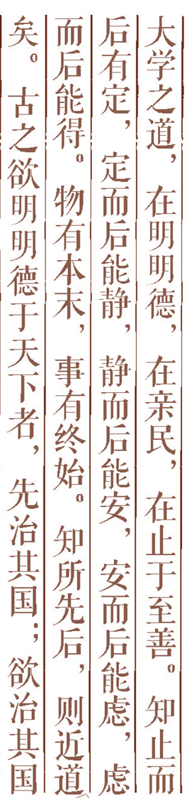
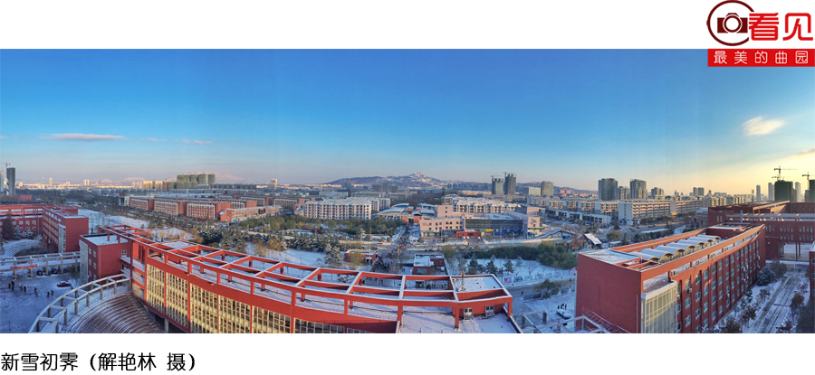

Artificial Intelligence Chapter 18 Representing Commonsense Knowledge (常识知识表示)
Chapter 17 第2讲

Slide 2



The Commonsense World
Time
Knowledge Representations by Networks
Additional Readings and Discussion
Outline

Slide 3
18.1 The Commonsense World
What Is Commonsense Knowledge
Most people know the fact that a liquid fall out if the cup is turned upside down. But how can we represent it ?
Commonsense knowledge
If you drop an object, it will fall.
People don’t exist before they are born.
Fish live in water and will die if taken out.
People buy bread and milk in a grocery store.
People typically sleep at night.

Slide 4
18.1.2 Difficulties in Representing Commonsense Knowledge
How many will be needed by a system capable of general human-level intelligence?
No one knows for sure.
No well-defined frontiers
Knowledge about some topics may not be easily captured by declarative sentences.
Description of a human face
Many sentences we might use for describing the world are only approximations.

Slide 5
18.1.3 The Importance of Commonsense Knowledge
Machine with commonsense
The knowledge such a robot would have to have!
Commonsense knowledge for expert systems
To recognize outside of the specific area, to predict more accurately.
Commonsense for expanding the knowledge of an expert system
To understanding natural language

Slide 6
18.1.4 Research Areas
Currently not available system with commonsense but,
Object and materials（对象和材料）: describing materials and their properties
Space（空间） : formalizing various notions about space
Physical properties(物理属性) : mass, temperature, volume, pressure, etc.
Physical Processes and events (物理过程和事件): modeling by differential equations v.s. qualitative physics without the need for exact calculation
Time : developing techniques for describing and reasoning about time

Slide 7
18.2 Time
How are we to think about time?
Real line: extending both into infinite past and infinite future
Integer: countable from beginning with 0 at ‘big bang’
[James 1984, Allen 1983]
Time is something that events and processes occur in.
“Interval” : containers for events and processes.
Predicate calculus used for describing interval
Occurs(E, I) : some event or process E, occupies the interval I.
Interval has starting and ending time points.

Slide 8
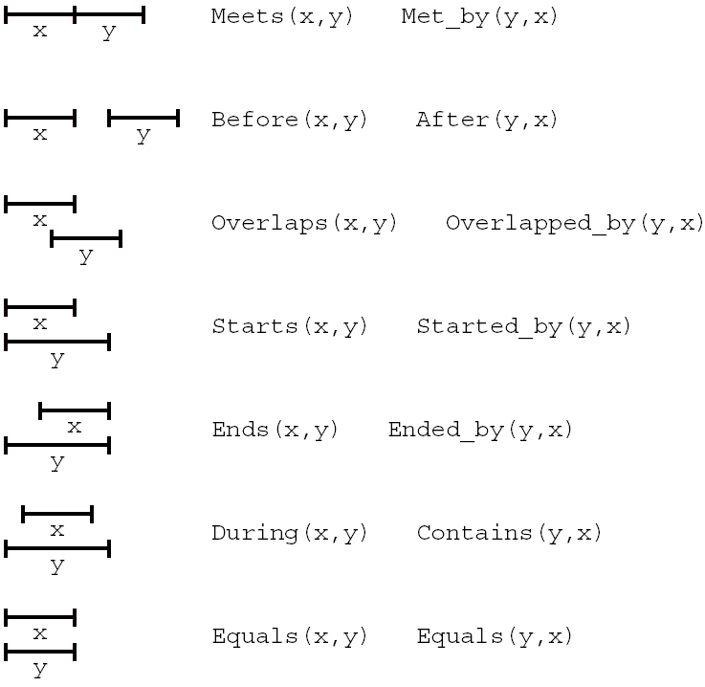

Slide 9
18.3 Knowledge Representation by Networks(用网络表示知识)
18.3.1 Taxonomic Knowledge；
18.3.2 Semantic Networks；
18.3.3 Nonmonotonic Reasoning
in Semantic Networks（语义网
络的非单调推理）
18.3.4 Frames

Slide 10
The entities of both commonsense and expert domains can be arranged in hierarchical structures that organize and simplify reasoning.
CYC system [Guha & Lenat 1990]
Taxonomic hierarchies : encoded either in networks or data structure called frames.

Slide 11
Example
“Snoopy is a laser printer, all laser printers are printers, all printers are machines.”
1. Laser_printer(Snoopy)
2. (∀x)[Laser_printer(x) ⊃ Printer(x)]
3. (∀x)[Printer(x) ⊃ Office_machine(x)]

Slide 12
18.3.2 Semantic Networks
Definition : graph structures that encode taxonomic knowledge of objects and their properties
Two kinds of nodes
Nodes labeled by relation constants corresponding to either taxonomic categories or properties
Nodes labeled by object constants corresponding to objects in the domain
Three kinds of arcs connecting nodes
Subset arcs (isa links)
Set membership arcs (instance links)
Function arcs

Slide 13
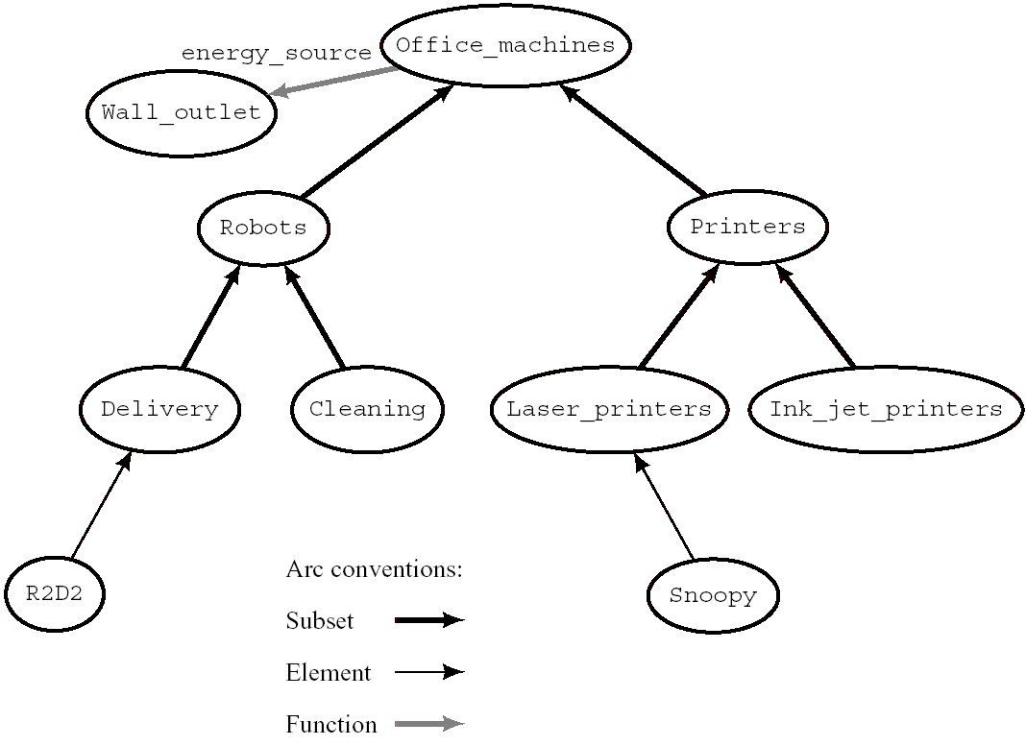
Figure 18.2 A Semantic network

Slide 14
18.3.3 Nonmonotonic Reasoning in Semantic Networks
Reasoning in ordinary logic is monotonic.
Because adding axioms to a logical system does not diminish the set of theorems that can be proved.
We must retract the default inference if new contradictory knowledge arrives.
Default inference : barring knowledge to the contrary, we are willing to assume are true.
Example of nonmonotonic reasoning : cancellation of inheritance.
By default, the energy source of office machines is electric wall outlet. But the energy source of a robot is a battery.

Slide 15
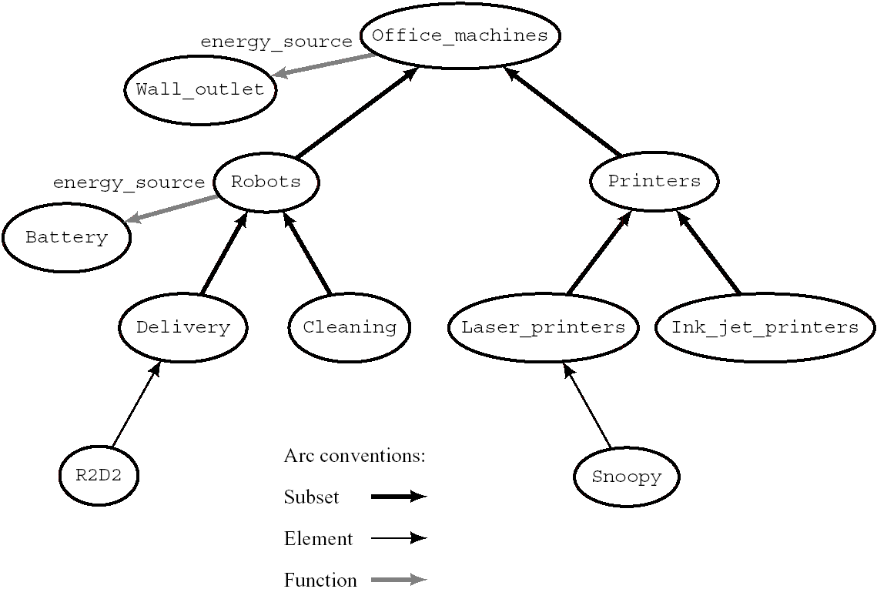

Slide 16
Figure 18.3 A Semantic Network for Default Reasoning
Adding another function arc
Contradiction from property inheritance can be resolved by the way in which information about the most specific categories takes precedence over less specific categories.

Slide 17
18.3.4 Frames
Frame is a Data structure which has a name and a set of attribute-value pairs (slots).
The frame name corresponds to a node in a semantic network.
The attributes (slot names) correspond to the names of arcs associated with this node
The values (slot fillers)correspond to nodes at the other ends of these arcs.
Semantic networks and frames do have difficulties in expressing certain kinds of knowledge
Disjunctions, negations, nontaxonomic knowledge
Hybrid system : KRYPTON, CLASSIC
Use terminological logic (employing hierarchical structures to represent entities, classes, and properties and logical expressions for other information).

Slide 18
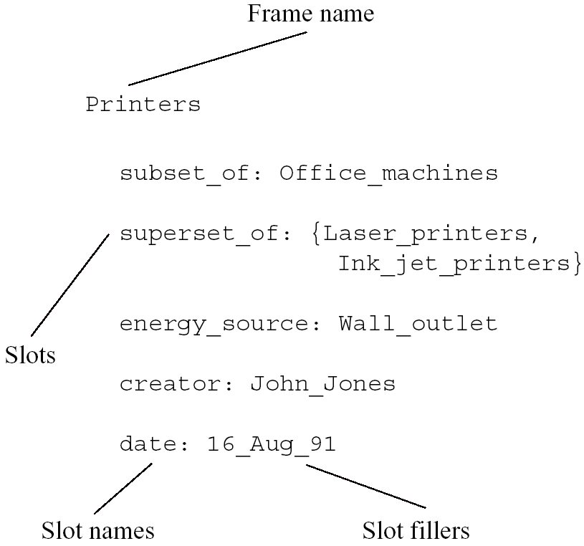

Slide 19
18.4 Additional Reading and Discussion
[Davis 1990, Hobbs & Moore 1985]
More commonsense representation and reasoning methods
[Lenat & Guha 1990]
CYC
[Sowa 1991]
Edited collection of papers
[Ginsberg 1987]
Nonmonotonic reasoning
[Gentner 1983]
Analogical reasoning

